Slide 1

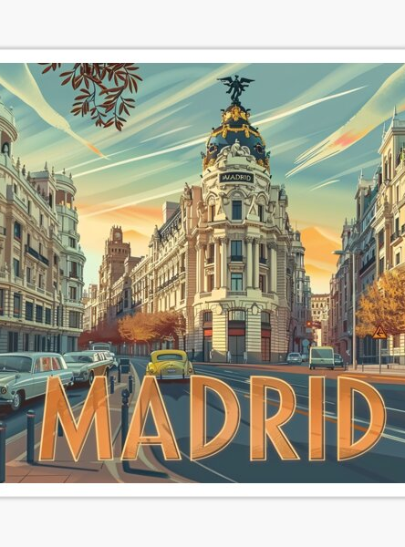

GO PLAN!!
Carla Gómez
Lorena Prior
Irene Aguado
Cristina Salinas
Lucía Palmero

Slide 2

INDEX
Introduction
Methodology
Results
Conclusions
Main Goal

Slide 3
Municipal Cultural centers
INTRODUCTION
Municipal cultural and leisure activities
Name of Activities and Events
Their Locations
Time Schedules
Description of the different activities and events

Slide 4


MAIN GOAL
To support citizens and tourists in discovering new spots
To discover alternative plans in the city
To promote participation in cultural activities

Slide 5
Users can:
Explore by map
Filtering by activity
Location
Select date
BUT HOW??

Slide 6
METHODOLOGY
Draw.io
RML mapper
GraphDB
Open Refine
Open Refine
python
Create Ontology
Data Pre-processing
Mappings
Data Linking
Data Publishing
Application

Slide 7

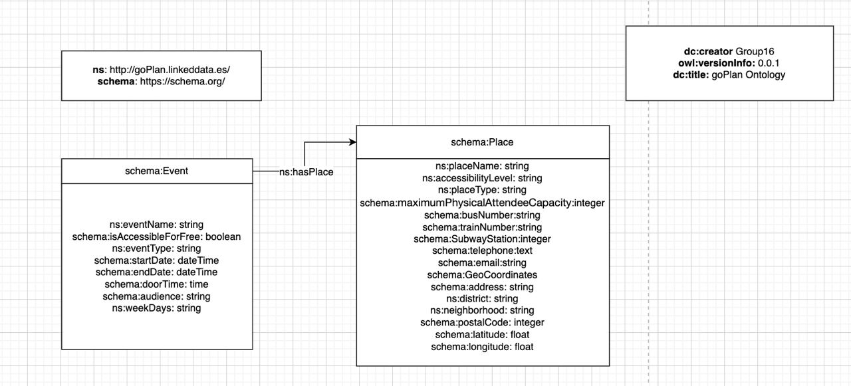
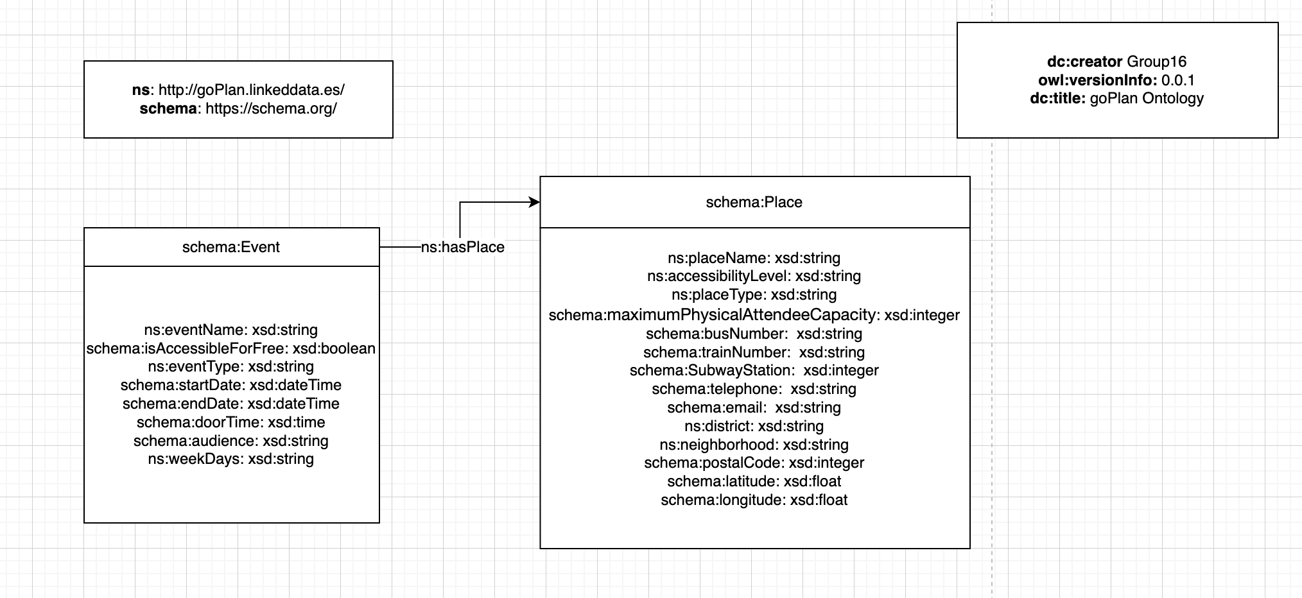
1
Create the Ontology

Slide 8
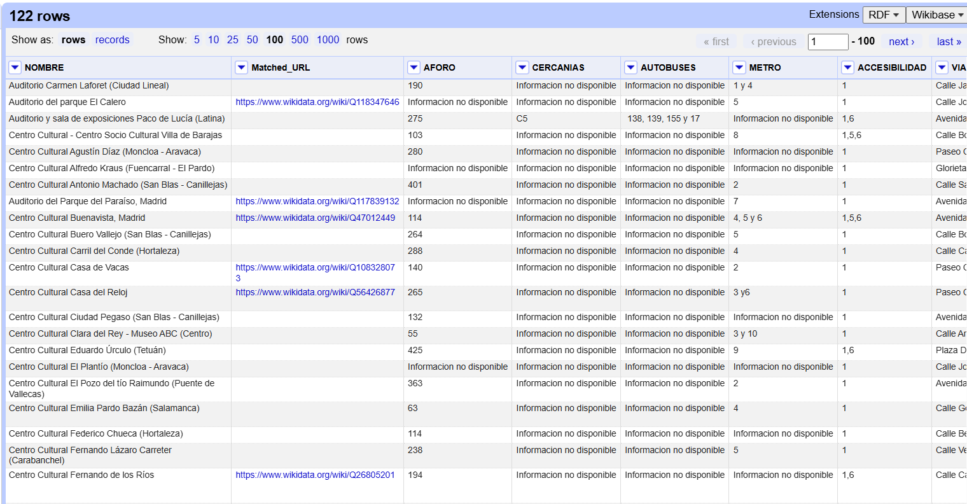

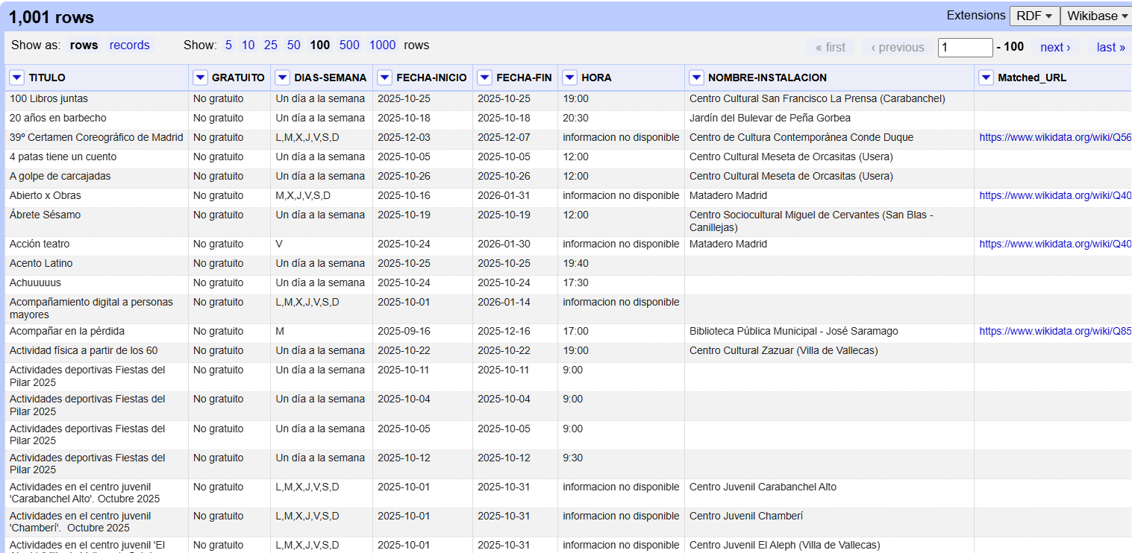
2
Data Preprocessing
Municipal cultural and leisure activities
Municipal Cultural centers

Slide 9

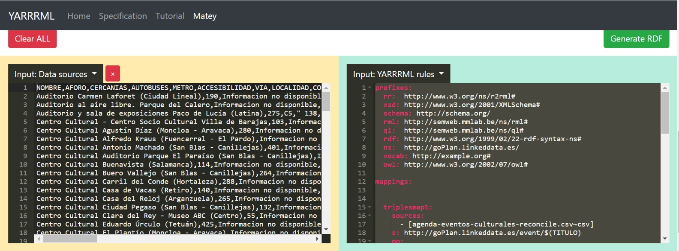
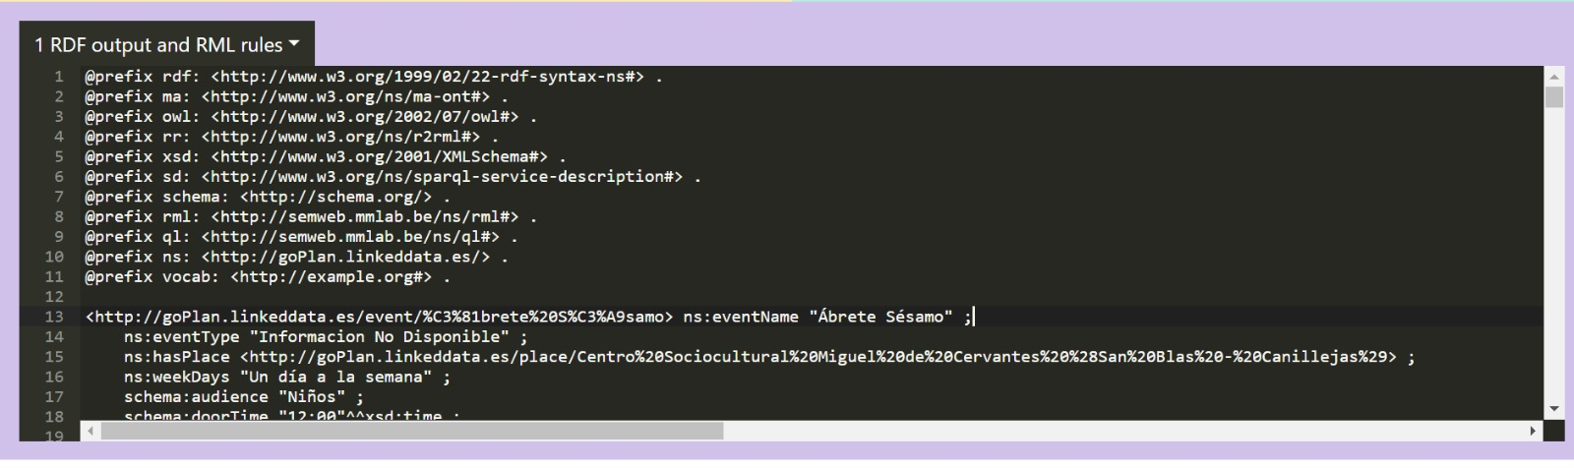
3
Insert 2 datasets
YARRRML rules
Mappings
Export in .ttl
RESULT IN RDF!!

Slide 10
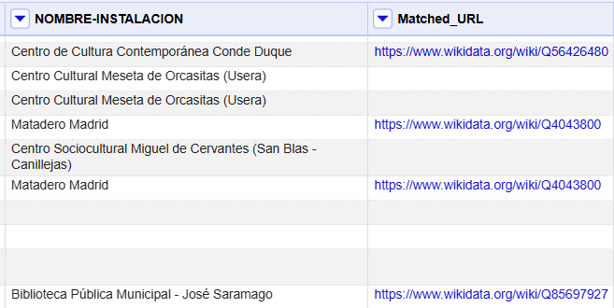
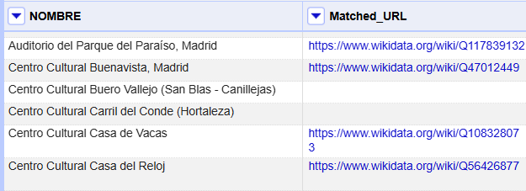
Municipal cultural and leisure activities
4
Data Linking
Municipal Cultural centers

Slide 11
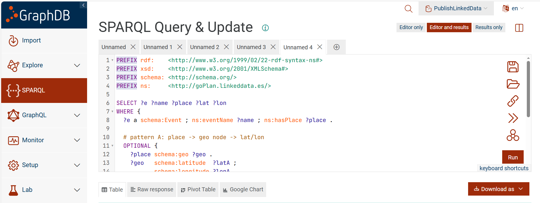

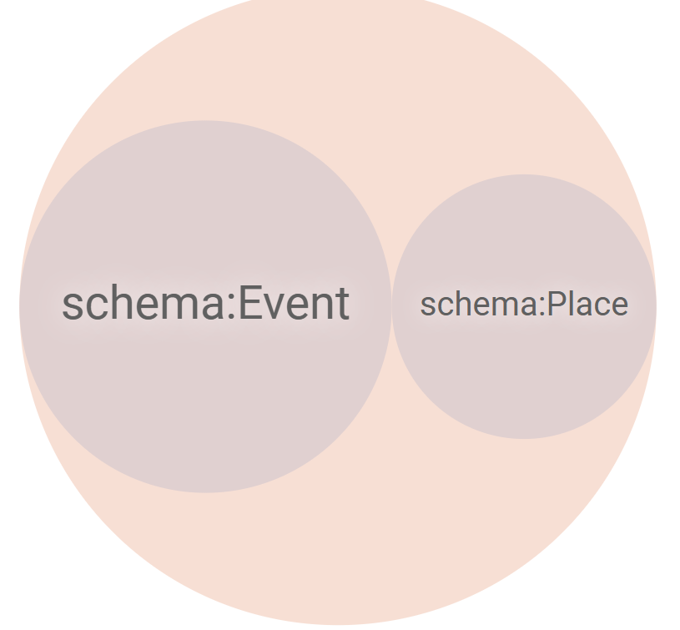
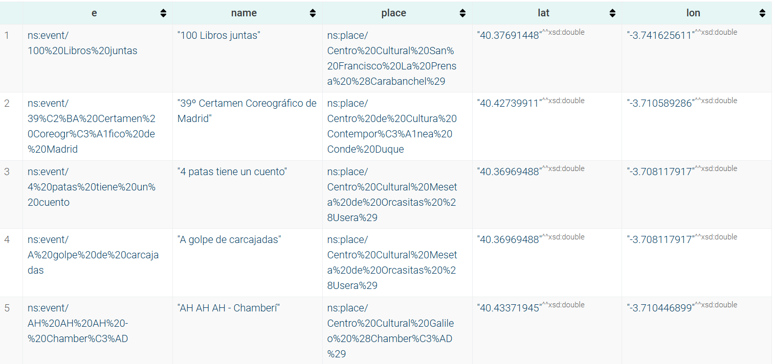
5
Data Publishing

Slide 12
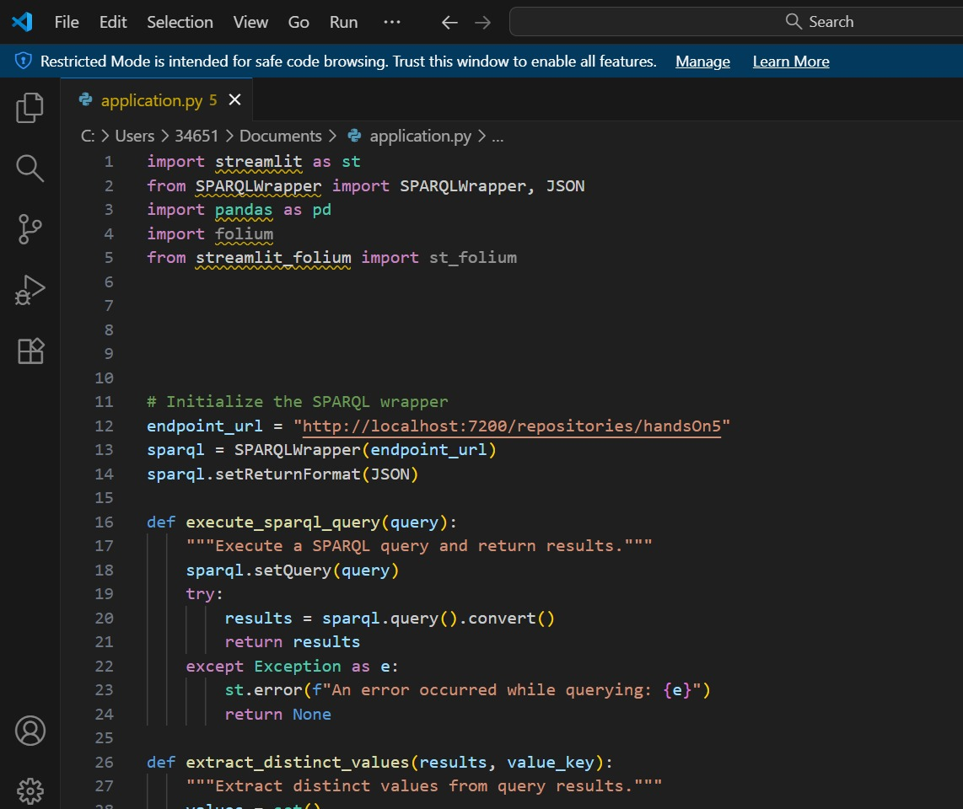

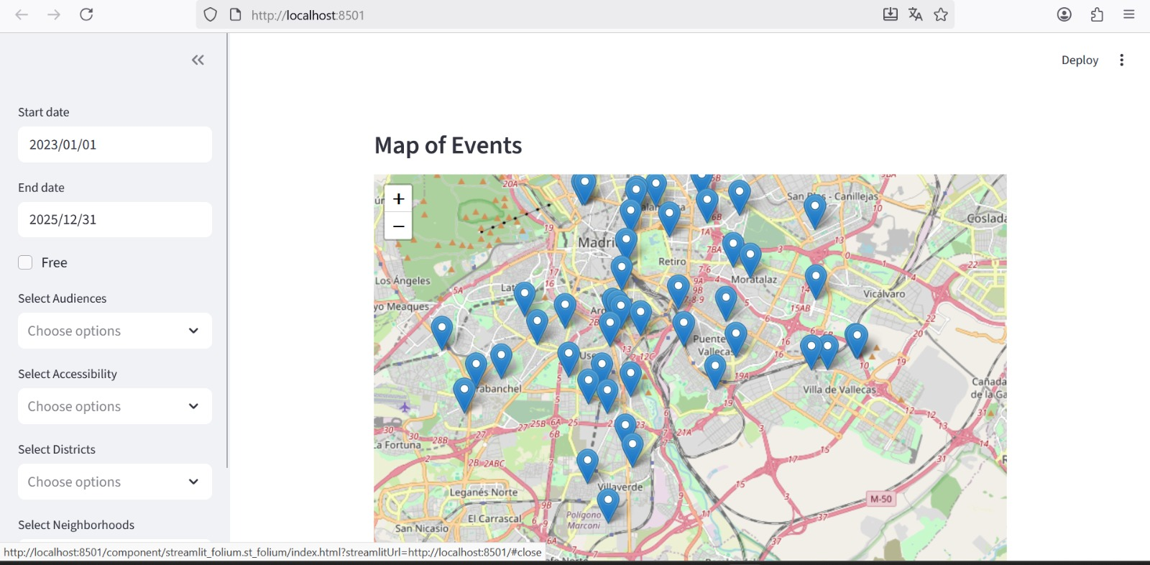
6
Application

Slide 13

VIDEO APP

Slide 14
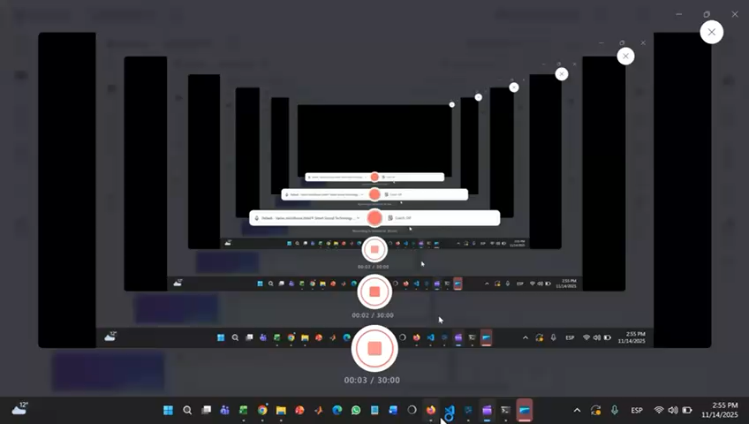

Slide 15

CONCLUSIONS
Easy and user-friendly application for accesing activities in cultural centers in Madrid
City map allowing users to select the centers and the dates they want to attend to
Customize their search based on interest

Slide 16

THANK YOU!!

